Slide 1

FaceRec: AI-Powered Face Recognition
With Age & Gender Detection | MCA Final Year Project

Slide 2
Introduction
This project teaches a computer to 'see' faces in real-time using a camera.
Like recognizing friends, the system learns unique patterns from faces.
Using smart tools (Haar Cascade) to quickly find faces in the video.
Employing a 'face fingerprinting' technique (LBPH) to identify individuals.
The goal is to accurately name people as they appear in front of the camera.

Slide 3
What is Deep Learning:
Machine Learning (ML) and Deep Learning are subsets of Artificial Intelligence. Deep Learning represents the next evolution in Machine Learning. In Deep Learning, the model learns through an artificial neural network that is very much similar to a human brain and this allows the model to analyse data in a structure much similar to humans do. Deep Learning models don’t require a human programmer to intervene and tell what to do with the data. It is self-capable of learning from the extraordinary amount of data provided to it.
In deep learning, a computer model learns to perform classification tasks directly from images, text, or sound. Deep learning models can achieve state-of-the-art accuracy, sometimes exceeding human-level performance. Models are trained by using a large set of labelled data and neural network architectures that contain many layers.

Slide 4
What is a Neural Network?
A neural network is a series of algorithms that endeavours to recognize underlying relationships in a set of data through a process that mimics the way the human brain operates. In this sense, neural networks refer to systems of neurons, either organic or artificial in nature. Neural networks can adapt to changing input; so the network generates the best possible result without needing to redesign the output criteria. The concept of neural networks, which has its roots in artificial intelligence, is swiftly gaining popularity in the development of trading systems.

Slide 5
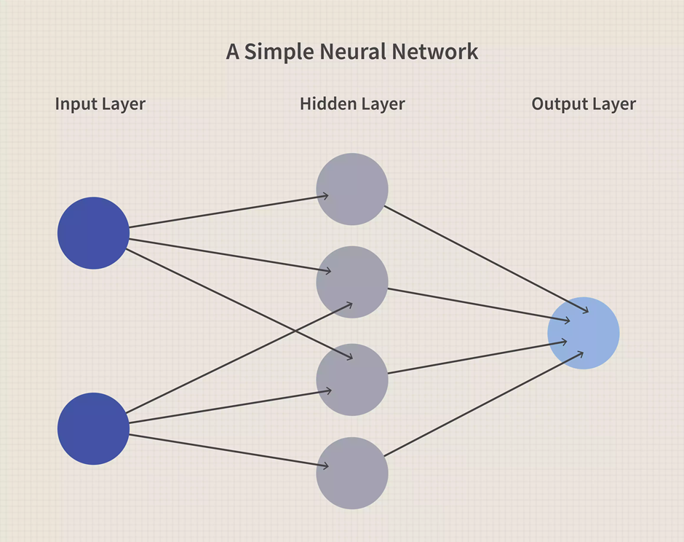
What is a Neural Network?

Slide 6
Computer Vision:
Computer vision provides the ability for the computer to see as humans see. It is the part of computer science that is focused on replicating the intricate parts of the human visual system. It helps identify and process the objects in images through the computer.
Deep learning has delivered superhuman accuracy for image classification, object detection, image restoration, and image segmentation. It uses enormous neural networks to teach machines how to automate the tasks performed by human visual systems. It is a field that aims to gain a deep understanding through digital images or videos.

Slide 7
Introduction To OpenCv
There are some predefined packages and libraries in python as part of Computer Vision which can make our life quite simple and OpenCV is one of them. It helps us develop a system that can process images and real-time video using computer vision. OpenCV (Open Source Computer Vision Library) is an open-source computer vision and machine learning software library which is easy to import in Python. We used HaarCascade algorithm in the model. It is a machine learning-based approach where a cascade function is trained using a whole lot of positive and negative images. It is then used to detect objects in other images.
Google Colab’s a browser-based Jupyter notebook service that’s available for free. This service is fit for Deep Learning and Machine Learning applications. It does not require any additional setup or installation. It helps us to run Python code via the browser. It also allows to share these notebooks without having to download them.

Slide 8
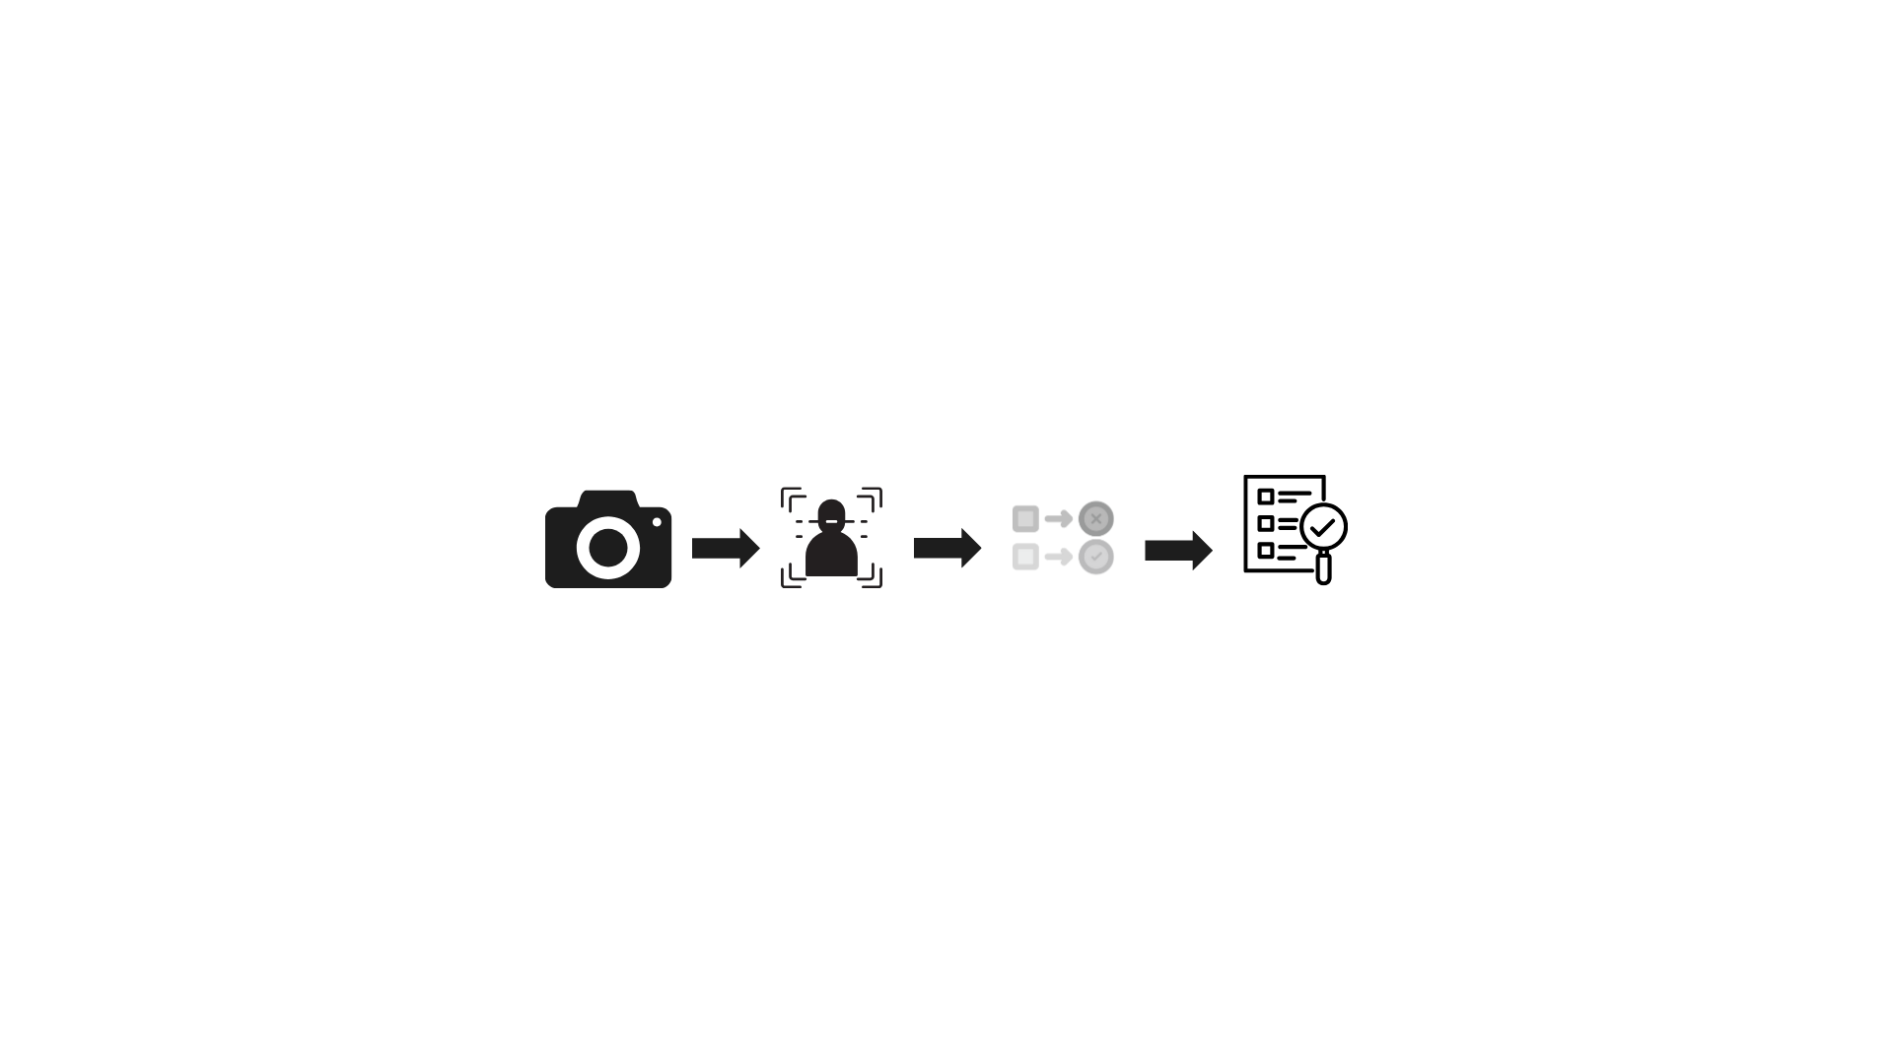
System Architecture
Think of this system like a set of building blocks. Each block does a specific job, and they all work together in a certain order to recognize faces. It's important that these blocks communicate well so the system can work quickly.

Slide 9



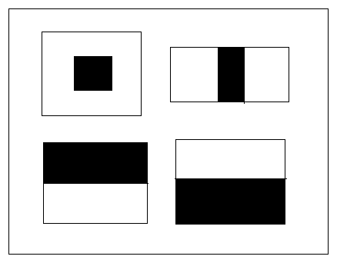
Technologies Used
Python
OpenCV – Open Camera Vision
NumPy – Numerical Python
Haarcascades – Filter designed to find specific things
LBPH – Local Binary Patterns Histogram

Slide 10
System Architecture
Step-by-Step Flow:
Input: Camera feed
Face Detection: Haar Cascade
Feature Extraction: LBPH
Matching: Compare with trained data
Output: Display name (if matched)

Slide 11
Dataset & Training
Dataset:
Folder structure: C:\Users\aadi\FaceRec\RealPeople\Aditya\IMG_20190925_112403.jpg
Training Process:
Grayscale conversion → Resize (100x100) → Train LBPH

Slide 12
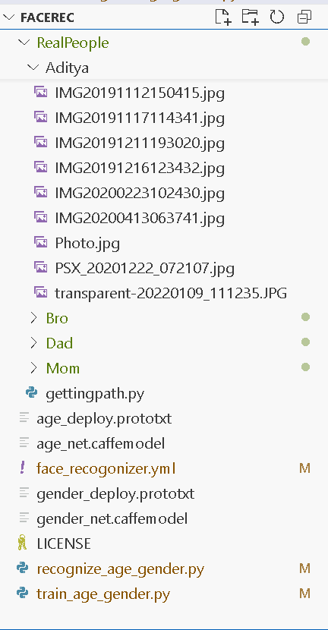
Directory Contents:

Slide 13
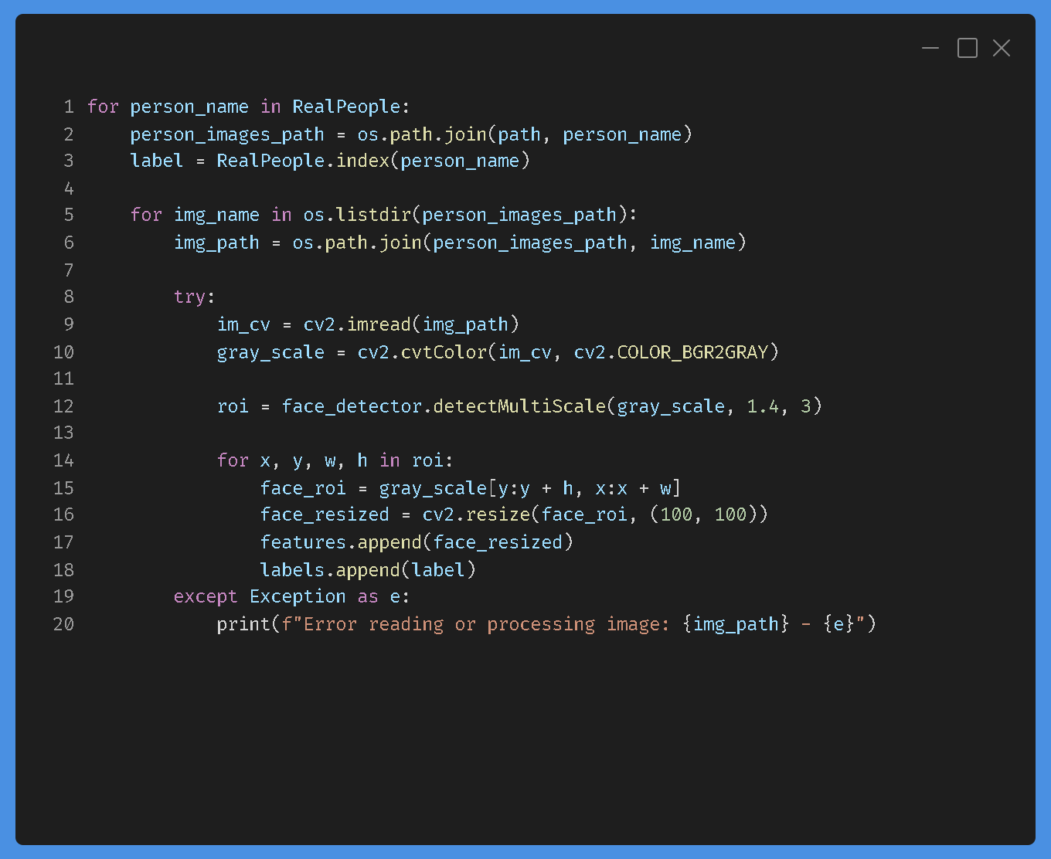
Training code snippet:

Slide 14
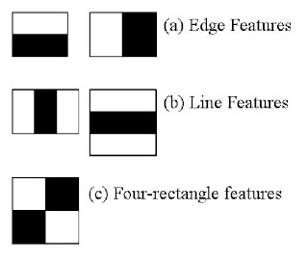
Face Detection (Haar Cascade) How it Works: Edge detection using rectangular filters.

Slide 15
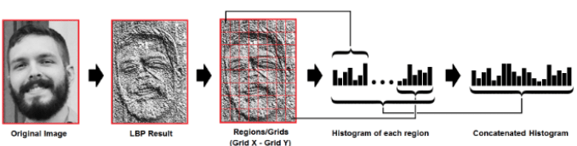
Face Recognition (LBPH)
LBPH Algorithm:
The Local Binary Patterns Histogram (LBPH) algorithm is a face recognition method that analyzes textures. It works by comparing each pixel in a grayscale image to its neighbors, assigning binary values to create a local binary pattern. The image is then divided into small regions, and histograms of these patterns are generated and combined into a single feature vector. During recognition, this feature vector is compared to those in a database using similarity measures. LBPH is efficient, robust to lighting changes, and ideal for real-time applications.

Slide 16
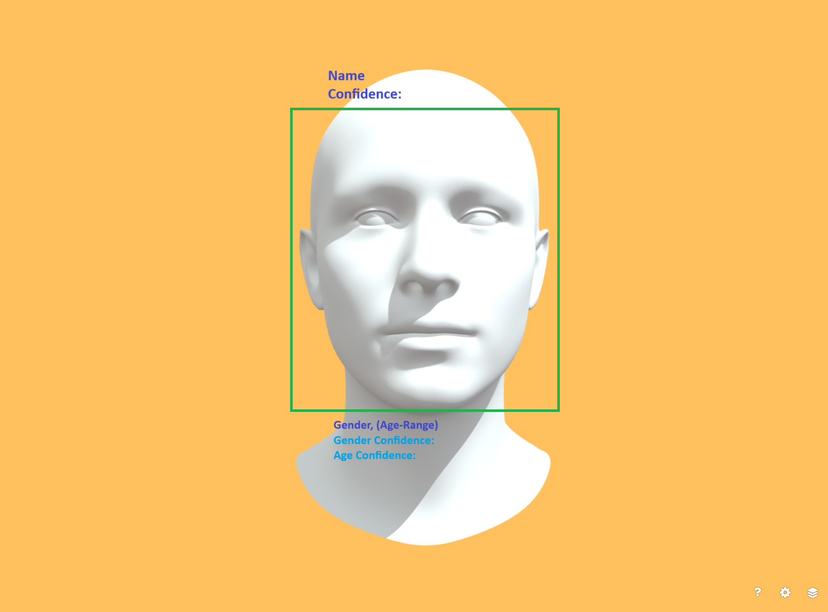
Real-Time Detection
How It Works:
Continuously checks camera feed for matches
Visual:

Slide 17
Results & Accuracy
Accuracy: ~85-95% (if well-lit)
Limitations:
Sensitive to lighting/angle changes.

Slide 18
Practical Applications
Smart Attendance
Smart Attendance
Smart Attendance
Smart Attendance
(A) Attendance Systems:
Replaces manual roll calls in classrooms/offices.
Matches faces against a registered database.
Example: "Automated college attendance with 90% efficiency."

Slide 19
(B) Security Access Control
Grants door access only to recognized personnel.
Logs entry/exit times.
Door Unlock
Door Unlock
Door Unlock
Door Unlock

Slide 20
(C) Personalized User Experiences
Identifies users to load custom profiles (e.g., smart mirrors, retail kiosks).
User Greeting
User Greeting
User Greeting
User Greeting

Slide 21
(D) Law Enforcement Support
Cross-checks CCTV footage against a suspect database.
Note: "Requires high-resolution images and ethical considerations."
Suspect X
CCTV1
CCTV2
Suspect Y

Slide 22


Future Work
Improvements:
Add mask detection.
Improve lighting resilience.

